Slide 1



TATA INSIGHTS AND QUANTS
Online Retail Analysis
Empowering Business with Effective Insights Using Power BI
PRESENTED BY:
Manishkumar Varma & Krishna Chauhan
B2-29 & B2-23

Slide 2

Introduction: Visualizing Online Retail Performance
03
The goal is to enable data-driven decisions through dynamic visuals that show key metrics such as total sales revenue, RFM customer types, sales by country, and monthly revenue trends.
01
This interactive Power BI dashboard provides a comprehensive analysis of Online Retail sales performance.
02
It uses data from the Online Retail CSV file to visualize sales revenue, quantity sold, customer segmentation, and performance trends across
different countries and time (months/years).

Slide 3

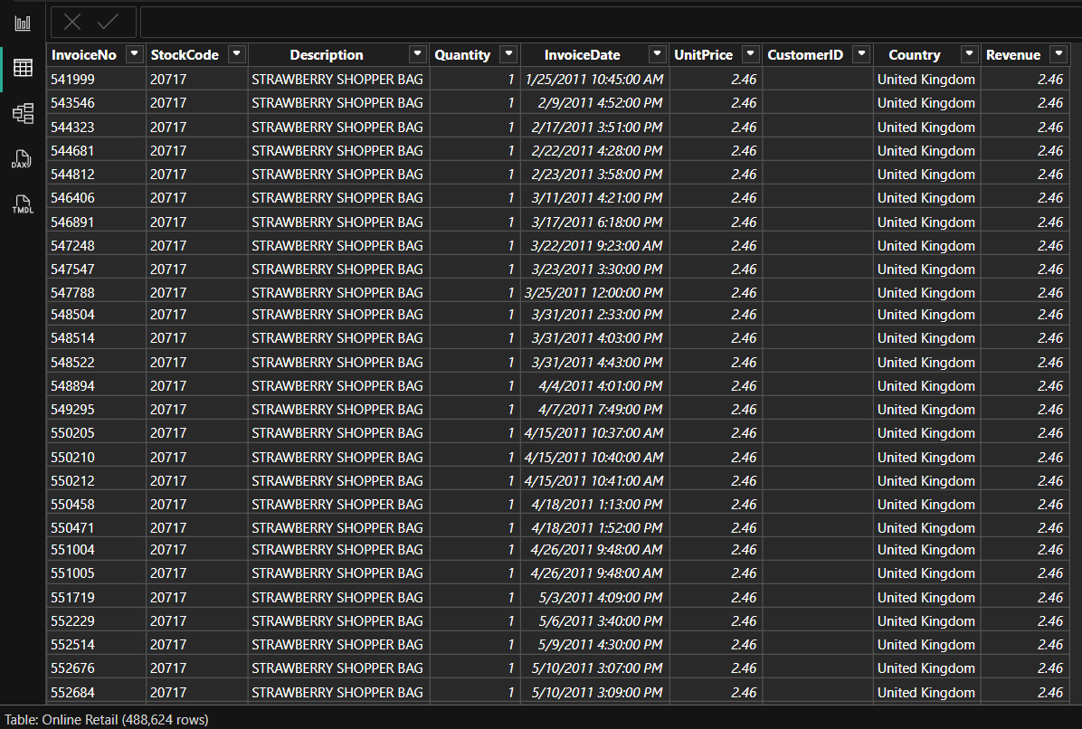

DATASET AND TOOLS USED
Tools & Technology
    Power BI for dynamic visualization
    Excel & CSV data sources
    Advanced DAX measures

Slide 4
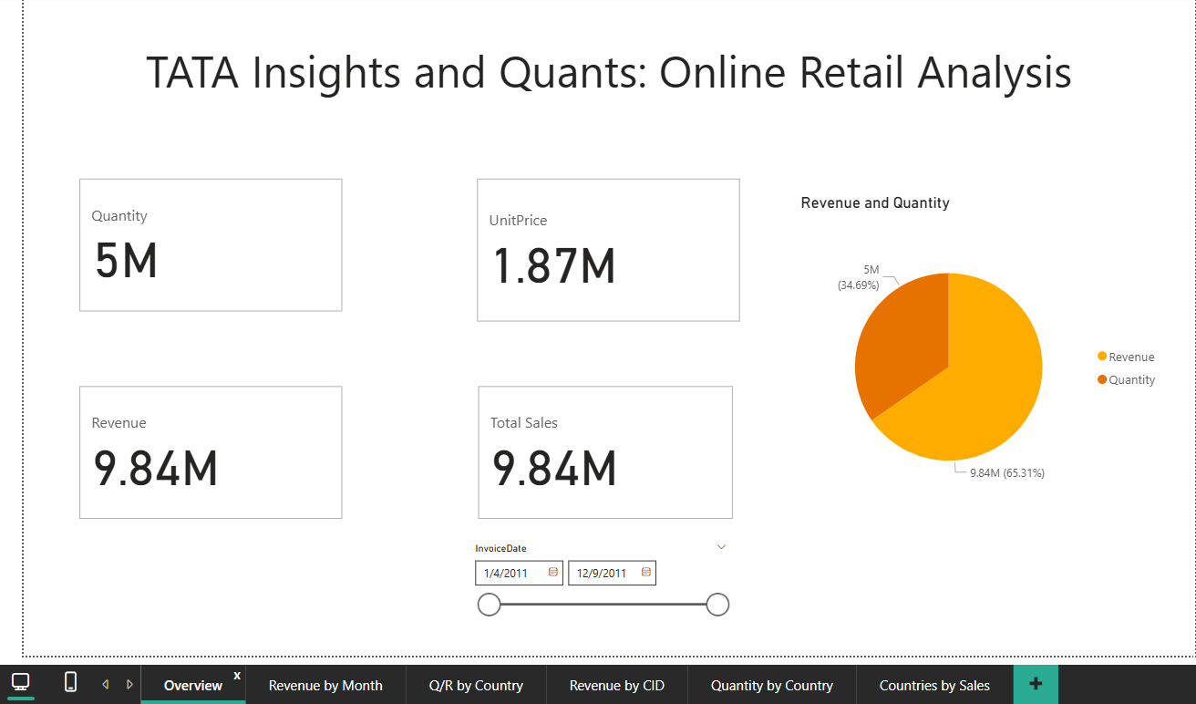
Dashboard

Slide 5
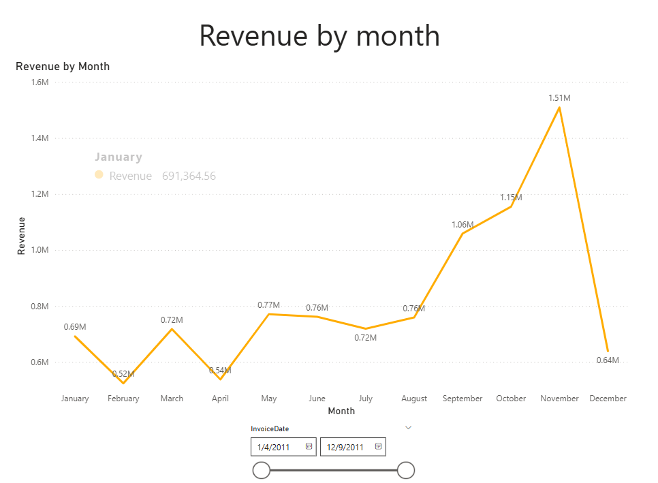
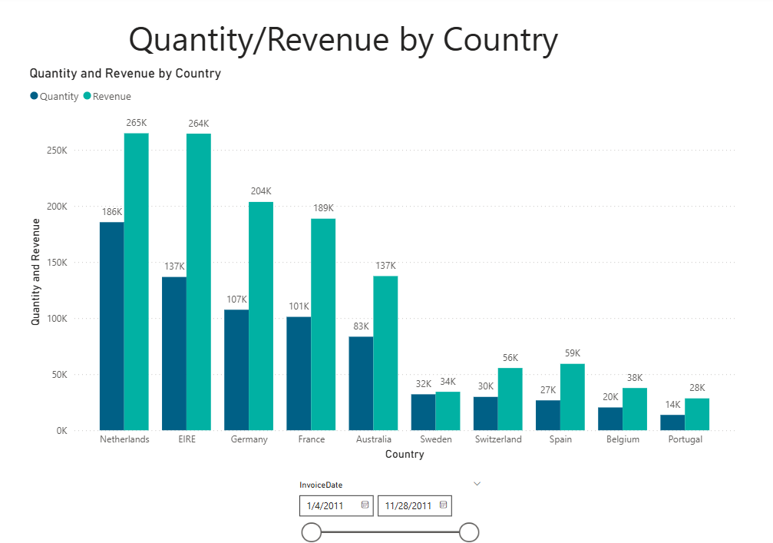
Visualizing our project's focus on Data, Insights, Sales, and Customers.

Slide 6
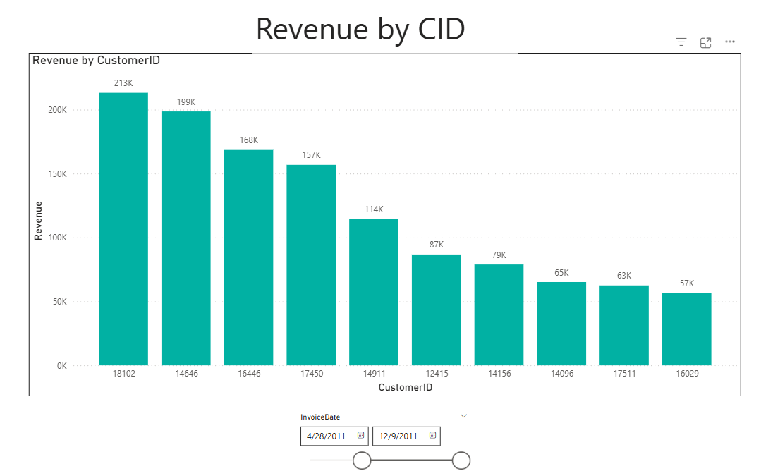
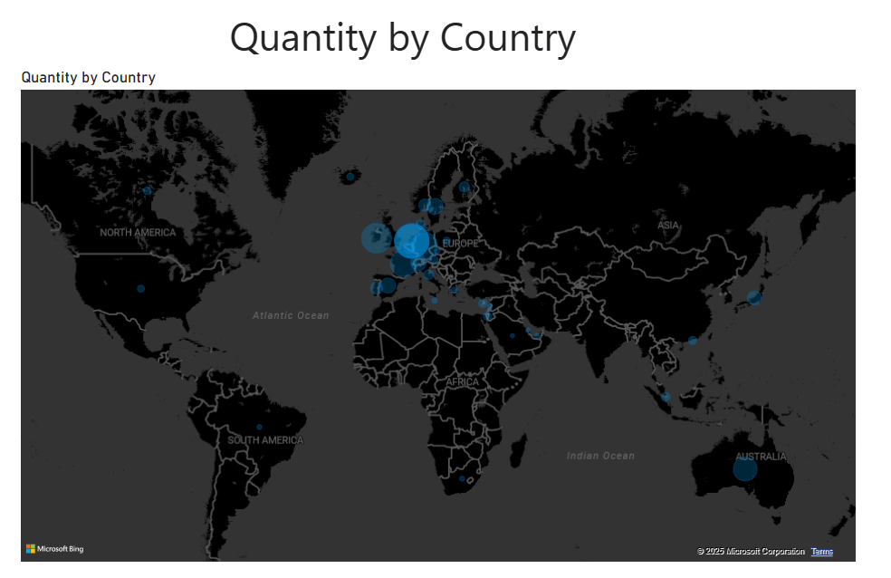
Sales Performance by Country

Slide 7
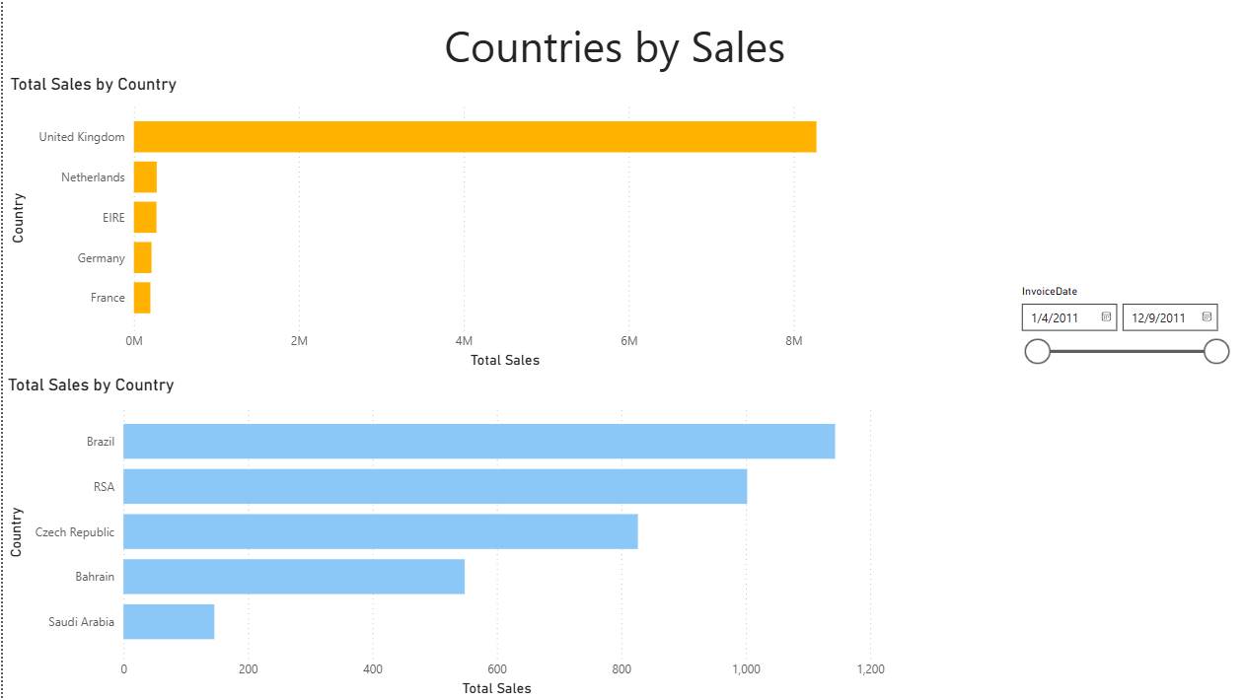
Global Sales Performance (By Quantity)

Slide 8
THANK YOU
Faculty : Dhanashree Mam & Nupur Mam

